Slide 1
OPIM 5604
Predictive Modeling
Discriminant Analysis
Jennifer Eigo, Instructor in-Residence

Slide 2
Discriminant Analysis: Background
A classical statistical technique
Used for classification long before data mining
  Classifying organisms into species
  Classifying skulls
  Fingerprint analysis
Used for business data mining (loans, customer types, etc.)
Can also be used to highlight aspects that distinguish classes (profiling)
Also called Linear Discriminant Analysis (LDA)

Slide 3
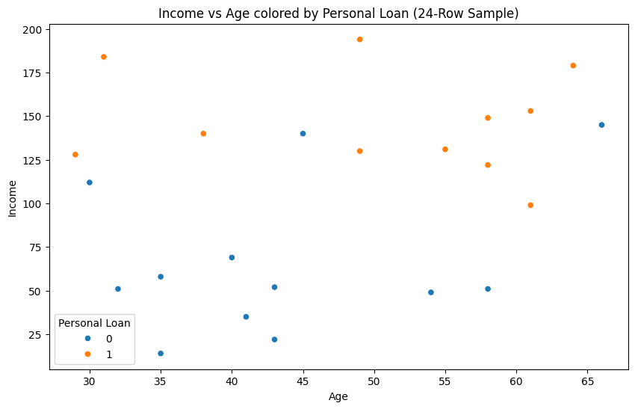
DA Small Example
Can we split the dataspace help with classification?

Slide 4
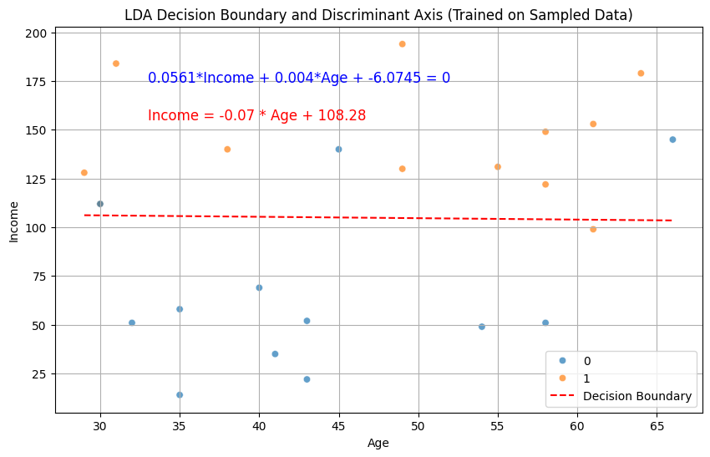
DA Small Example
Predict 1 above the line and 0 below the line.

Slide 5
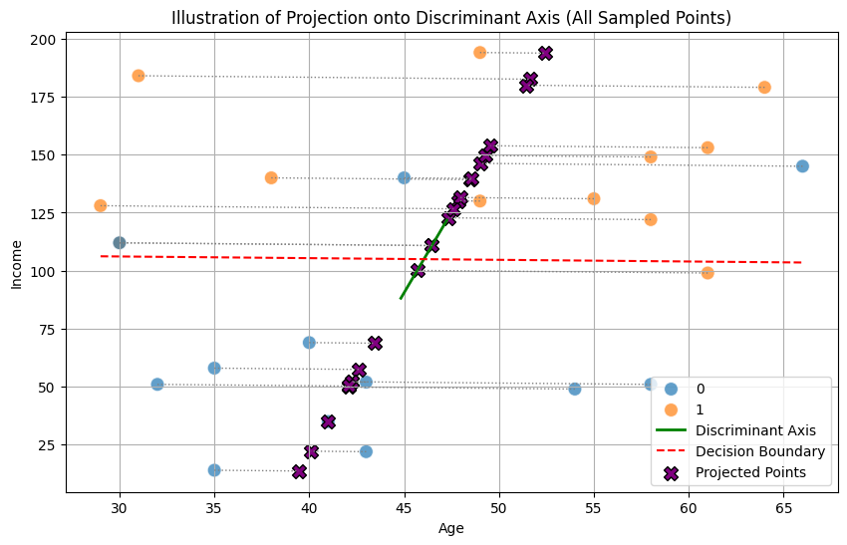
DA Small Example
Project each point to the discriminant axis.

Slide 6
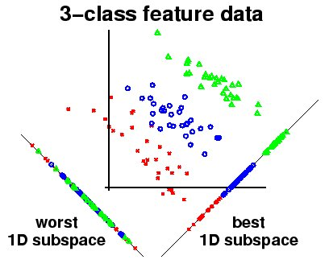
DA General Example
Project each point to the discriminant axis.
https://www.dtreg.com/solution/linear-discriminant-analysis

Slide 7
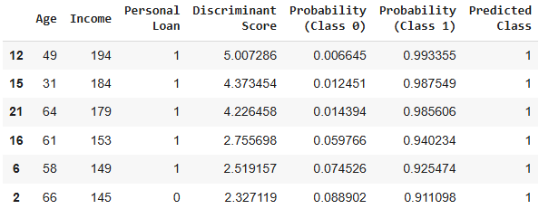
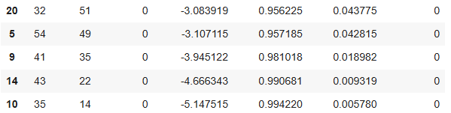
DA Small Example
Discriminant scores show
position along the new axis.
If Score > 0
then predict 1
…
If Score < 0
then predict 0

Slide 8
Discriminant Analysis
DA's goal for placement of discriminant function:
Find the single linear boundary that best separates the classes overall
  Maximize the distance between the class means
  Minimize the relative variance within each class
Not minimizing classification errors
DA is finding a projection that makes the classes as distant from each other as possible (in terms of their centers) while making the points within each class as close to each other as possible (in terms of their spread).

Slide 9
Summary
Discriminant analysis is based on grouping projects of the data on a new axis
Suitable for small datasets
Requires continuous variables
Assumes formality of predictors within each class
Sensitive to outliers (explore the data first!)
Discriminant functions useful for profiling: can order predictors in terms of separating the classes

